Slide 1
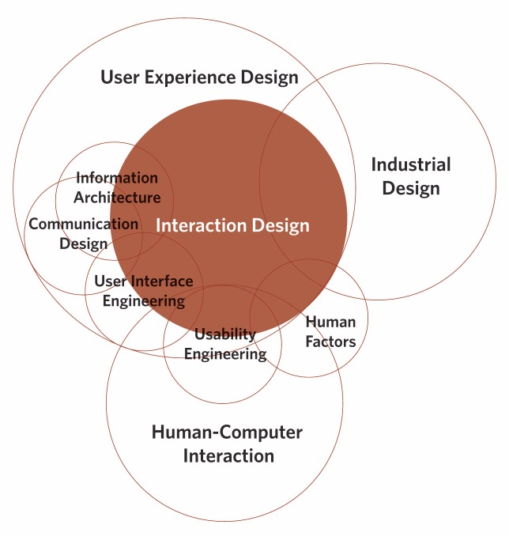
Interaktion og Interaktionsdesign

Slide 2
DAGENS PROGRAM
INTRODUKTIONER
PLAN FOR ÅRET
HVAD SKAL VI FORSTÅ VED:
”Udvikling af interaktive systemer til menneskser”?
ØVELSE
LIDT SHOW AND TELL

Slide 3
PRAKTISK INFORMATION
Yngve Gregoriussen
Mail: Yng@sdu.dk
Fagbeskrivelse
Portefølgeopgave + Eksamen

Slide 4
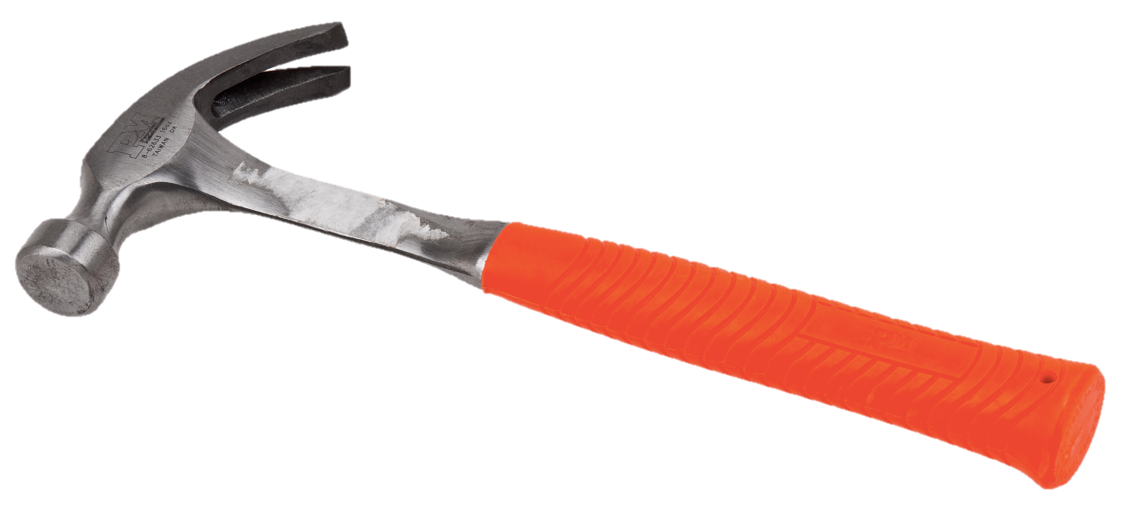
HAMMEREN

Slide 5

HiPPO’s
Notes:
The person at the top makes the call.
Data makes the call.
Google insiders, and A/B enthusiasts more generally, have a derisive term to describe a decisionmaking system that fails to put data at its heart: HiPPO—”highest-paid person’s opinion.” As Google analytics expert Avinash Kaushik declares, “Most websites suck because HiPPOs create them.”
Tech circles are rife with stories of the clueless boss who almost killed a project because of a “mere opinion.” In Amazon’s early days, developer Greg Linden came up with the idea of giving personalized “impulse buy” recommendations to customers as they checked out, based on what was in their shopping cart. He made a demo for the new feature but was shot down. Linden bristled at the thought that the idea might not even be tested. “I was told I was forbidden to work on this any further. It should have stopped there.”
Instead Linden worked up an A/B test. It showed that Amazon stood to gain so much revenue from the feature that all arguments against it were instantly rendered null by the data. “I do know that in some organizations, challenging an SVP would be a fatal mistake, right or wrong,” Linden wrote in a blog post on the subject. But once he’d done an objective test, putting the idea in front of real customers, the higher-ups had to bend. Amazon’s culture wouldn’t allow otherwise.
Says WePay’s Bill Clerico: “On Facebook, under the heading of Religious Views, my profile says: ‘In God we trust. All others, bring data.’”

Slide 6
INTERAKTIONSDESIGN?!
Notes:
The person at the top makes the call.
Data makes the call.
Google insiders, and A/B enthusiasts more generally, have a derisive term to describe a decisionmaking system that fails to put data at its heart: HiPPO—”highest-paid person’s opinion.” As Google analytics expert Avinash Kaushik declares, “Most websites suck because HiPPOs create them.”
Tech circles are rife with stories of the clueless boss who almost killed a project because of a “mere opinion.” In Amazon’s early days, developer Greg Linden came up with the idea of giving personalized “impulse buy” recommendations to customers as they checked out, based on what was in their shopping cart. He made a demo for the new feature but was shot down. Linden bristled at the thought that the idea might not even be tested. “I was told I was forbidden to work on this any further. It should have stopped there.”
Instead Linden worked up an A/B test. It showed that Amazon stood to gain so much revenue from the feature that all arguments against it were instantly rendered null by the data. “I do know that in some organizations, challenging an SVP would be a fatal mistake, right or wrong,” Linden wrote in a blog post on the subject. But once he’d done an objective test, putting the idea in front of real customers, the higher-ups had to bend. Amazon’s culture wouldn’t allow otherwise.
Says WePay’s Bill Clerico: “On Facebook, under the heading of Religious Views, my profile says: ‘In God we trust. All others, bring data.’”

Slide 7
INTERAKTIONSDESIGN?!
Ingeniører tænker traditionelt set meget i teknologiske konstruktioner.
Brugervenlighed!
Brugeroplevelse!
Analyse, design og prototypeudvikling
Metoder og principper
Evaluering
Der findes interaktionsdesignere derude ☺
Vores samfund er ved at ændre sig fra at være materialistisk til at blive mere oplevelsesorienteret.

Slide 8
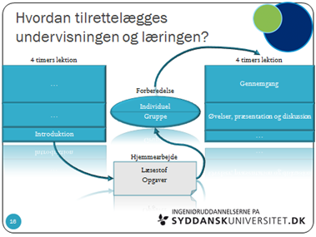
UNDERVISNINGEN

Slide 9
FORELÆSNINGER
Rogers, Sharp og Preece: Interaction Design – beyond human computer interaction, 4th edition, 2015.
Lidt andet godt og blandet
Sideløbende med semesterprojektet
Struktureret efter et projektforløb
Ændret på rækkefølgen af kapitlerne

Slide 10
OPGAVER
2 Portefølgeopgaver
NR 1:
Centreret om en case & test
NR 2:
Primært fokuseret på teksterne
Fokus på akademisk form

Slide 11
VÆRKTØJER
Fokus på prototyping
Mock-ups
MIT APP Inventor
POP – Prototyping on Paper
Papir og blyant
Gimp / Photoshop

Slide 12
HVEM SKAL VI LÆRE AT KENDE?
Don Norman
Bill Verplank
Charles Sanders Peirce
Og mange flere

Slide 13
DESIGN
Is concerned with how things work, how they are controlled, and the nature of the interaction between people and technology.
Done right = pleasureble
Done bad = unusable, frustrating and irritation (og passende fremmedgørelse – og man føler sig slet og ret dum)
Maskine = følger bestemt orden
Menneske = sammensurium af ”common sense”
Hvem skal forstå hvem? (centralt udgangspunkt)

Slide 14
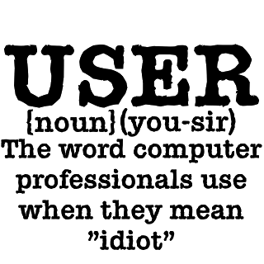
BRUGERE

Slide 15
INGENIØRER
”Engineers, moreover, make the mistake of thinking that logical explanation is sufficient: “If only people would read the instructions,” they say, “everything would be all right.” Engineers are trained to think logically.
As a result, they come to believe that all people must think this way, and they design their machines accordingly. When people have trouble, the engineers are upset, but often for the wrong reason. “What are these people doing?” they will wonder. “Why are they doing that?” The problem with the designs of most engineers is that they are too logical.
We have to accept human behavior the way it is, not the way we would wish it to be.” (p.6)
”I used to be an engineer, focused upon technical requirements,
quite ignorant of people” (p. 7)

Slide 16
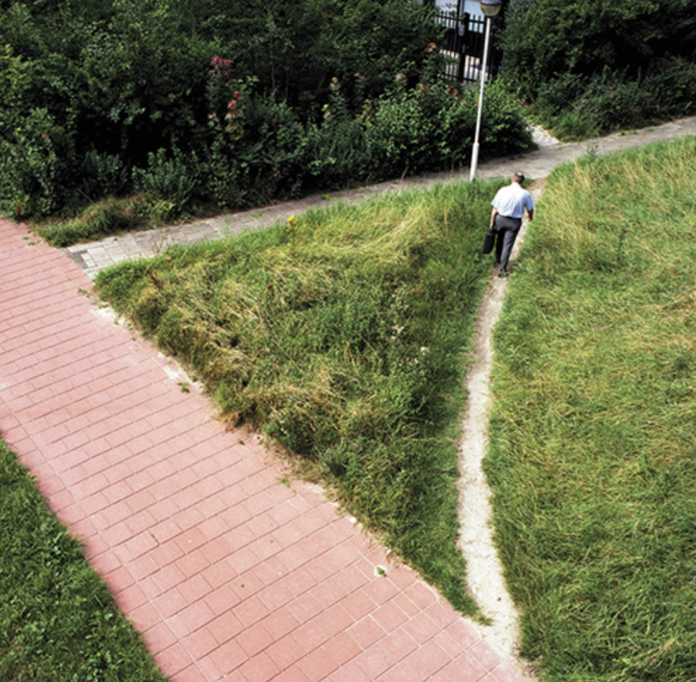

Slide 17
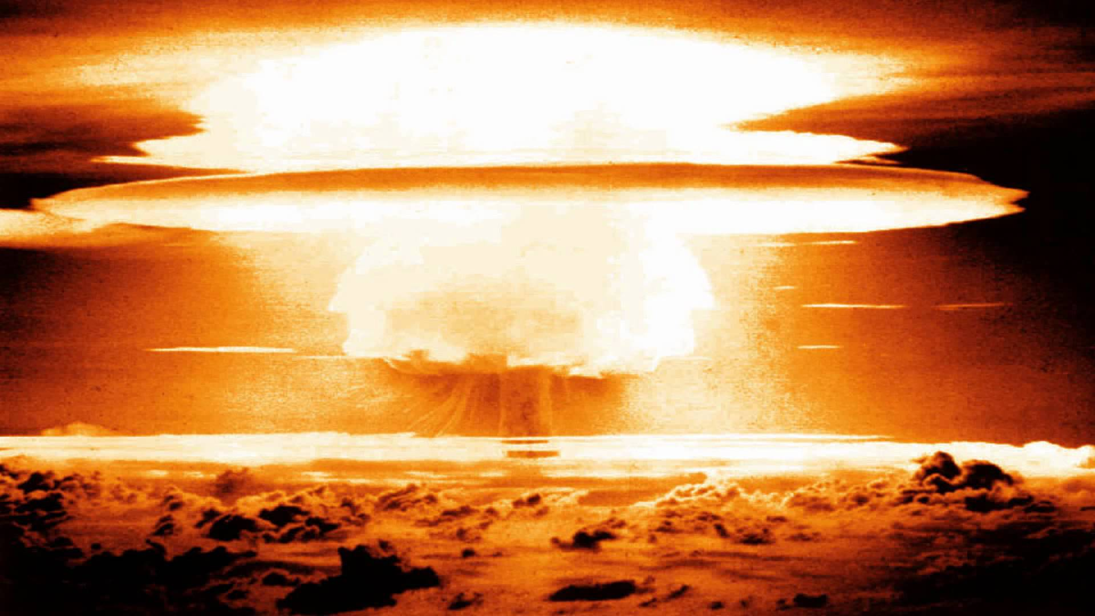

Slide 18
Tre-mile øen
”The moral was simple: we were designing things for people, so we needed to understand both technology and people. But that’s a difficult step for many engineers: machines are so logical, so orderly. If we didn’t have people, everything would work so much better. Yup, that’s how I used to think” (p.7)
Hvad er løsningen?

Slide 19
Hvad er ”godt” design?
To design a pleasureble experience?
Hvad er en experience?

Slide 20
”Discoverability”
Affordances (er relationen mellem objekt og agent – stol affords sitting (knapper = trykke på, Håndtag= hive i ?Flere?) (affordance er IKKE en egenskab ved tingen!!!)
Affordance = muligheder for interaktion
Signifiers ?

Slide 21
MULIGHEDER OG BETINGELSER?
Constraints (physical, cultural, semantical and logical)
(operating something unknown => knowledge (conceptual models, cultural semanstics, and logical constrains (what can be done – lego police)
A) Physical constraints = limit possible operations (stik og stikkontakter – passer) (modsat batteri – to veje) => legacy problem (at den slags design overlever)(samme med nøgler – hvad er op og ned?).

Slide 22
B) Cultural constrains (allowed actions for social situations). Knowing how to behave in a restaurant or in an elevator.
c) Semantic contraints (gentandes mening skifter)
d) Logical constraints (Oops – the leftover part)

